Slide 1
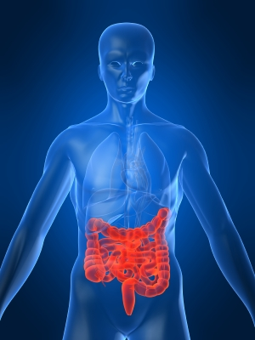
Inflammatory
Bowel
Disease

Slide 2
Learning outcomes
LO1: Introduction
LO2: Occurrence & Commonness
LO3: Pathophysiology
LO4: Diagnosis (Symptoms and Signs)
LO5: Complications
LO6: Treatments (Medical and Surgical)

Slide 3
LO1: Introduction:
IBD: Chronic inflammatory diseases of GI tract of unknown etiology
Commonly refers to 1) ulcerative colitis Ulcerative colitis (UC) affects only the large intestine.
2) Crohn’s disease Crohn’s disease (CD) can affect any part of the gastrointestinal tract but most frequently attacks the distal third of the small intestine & the colon.

Slide 4
Other forms of IBD
Collagenous colitis
Lymphocytic colitis
Ischemic colitis
Behcet’s syndrome
Infective colitis
Intermediate colitis

Slide 5
Pathophysiology
Notes:
PATHOGENESIS OF IBD
Although genetic susceptibility, luminal antigenic drive, and environmental triggers are each important, animal models demonstrate that no single factor is sufficient to induce chronic relapsing, immune-mediated intestinal inflammation. Chronic inflammatory bowel diseases depend on the interaction of these essential components, each of which is necessary but not sufficient to induce disease.

Slide 6
Environment
UC: Common in non smoker and in ex smoker.
CD: Common in smokers.
Appendicetomy protects against UC.
Diet :
associated with low residue and high refined sugar diet
Bacteria:
Mycobacterium, listeria and endogenous bac.
Virus:
Measles…

Slide 7
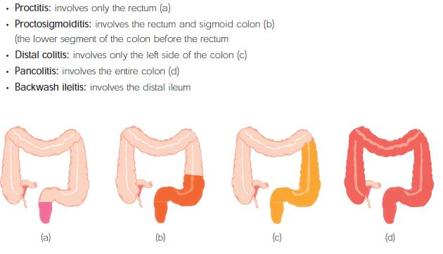

Slide 8
IBD
Both UC and CD have waxing and waning in intensity and severity
In most cases, symptoms correspond with degree of inflammation
When patient is actively symptomatic, significant inflammation = flare-up of IBD
When asymptomatic, inflammation absent (or less) = in remission

Slide 9
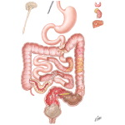
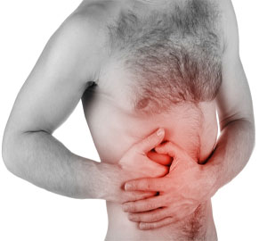
Clinical features
Ulcerative colitis
Diarrhea bloody-intermittent
mild. do not seek medical attention.
Rectal bleeding patient with
Proctitis -pass fresh or blood stained mucus with formed or semi formed stool.
Crampy abdominal pain

Slide 10
They also have tenesmus , urgency with feeling of incomplete evacuation.
With proctosigmoiditis - constipation
Severe disease-liquid stools with blood , pus & fecal matter.

Slide 11
Physical signs
Proctitis – Tender anal canal & blood on rectal examination
Extensive disease-tenderness on palpation of colon.
If perforation-signs of peritonitis

Slide 12
Clinical features
Ileal Crohn’s Disease
Abdominal pain
Diarrhea
Weight loss
Low grade fever
Jejunoileitis disease
Malabsorption
Steatorrhea

Slide 13
Colitis and perianal disease
Bloody diarrhea
Passage of mucus
Lethargy
Malaise
Anorexia
Weight loss

Slide 14
Extra-intestinal manifestations of IBD
Arthritis:
Peripheral arthritis, usually parallels the disease activity
Ankylosing Spondylitis, 1-6%, sacroiliitis
Ocular lesions:
Iritis (uvietis) (0.5-3%), episcleritis, keratitis,
Skin and oral cavity:
Erythema nodosum 1-3%
Pyoderma Gangrenosum 0.6%
Aphthous, stomatitis.

Slide 15
Extra-intestinal manifestations of IBD
Primary sclerosing cholangitis: occurs in 5% of patients with UC & may occur in Crohn's disease as well.
These patients may have recurrent episodes of cholangitis as well as a malignant transformation to cholangiocarcinoma& a much higher than normal incidence of colorectal cancer.
Therapy with ursodeoxycholic acid has been shown to be chemoprotective against colon cancer.
Notes:
15

Slide 16
Differential diagnosis
Anorexia nervosa
Appendicitis
Celiac sprue
Clostridium difficile colitis
Giardiasis
Lactose intolerance
Chronic pelvic pain
Diverticulitis
Pseudomembranous colitis
Salmonellosis
IBS (Irritable Bowel Syndrome)

Slide 17
Diagnosis UC
Laboratory tests
Endoscopy
Radiography
Biopsy
Notes:
L2

Slide 18
Laboratory tests
Hematological
C-reactive protein is increased
ESR is increased
Platelet count-increased
Hemoglobin-decreased
Fecal calprotectin levels correlate with histological inflammation, predict relapses &detect pouchitis

Slide 19
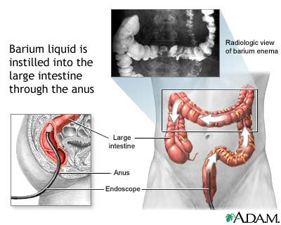
Barium enema

Slide 20
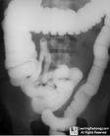
Barium enema
Fine mucosal granularity
Superficial ulcers seen
Collar button ulcers
Pipe stem appearance-
loss of haustrations
Narrow & short colon-
ribbon contour colon

Slide 21
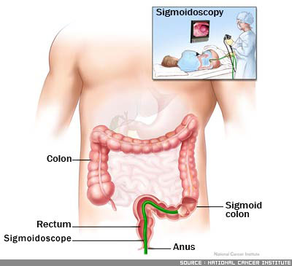
Sigmoidoscopy
Always abnormal
Loss of vascular patterns
Granularity
Friability
ulceration

Slide 22
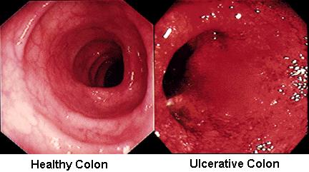

Slide 23
Diagnosis CD
Laboratory tests
Endoscopy
Radiography
Biopsy
CT enterography

Slide 24
Laboratory tests
CRP-elevated
ESR-elevated
Anemia
Leukocytosis
hypoalbuminaemia

Slide 25
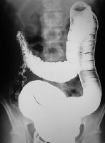
Barium enema
String sign

Slide 26
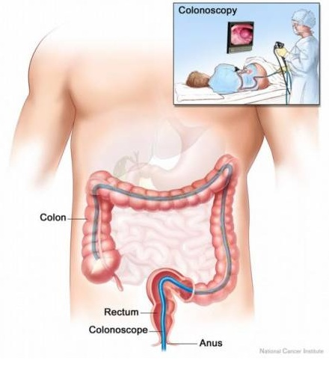
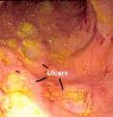
Colonoscopy

Slide 27
Complications
Toxic megacolon
abdominal pain, distention
Dilated colon – allows bacteria to leak into bloodstream, increases risk of perforation and peritonitis
If no improvement, usually treated with colectomy

Slide 28
Strictures which can lead to obstruction
Fistulas & abscesses (more common in CD, but also 20% UC)
Fistula types: enterovesical, enteroenteric, enteromesenteric, enterocutaneous, rectovaginal & perianal
In CD, obstructive hydronephrosis ( compressing rt. ureter)
Sepsis, malnutrition in Crohn’s

Slide 29
Risk of Malignancy in IBD
In Crohn’s disease, increased risk of cancer of the affected areas (*)
In ulcerative colitis, 8-10 years after initial diagnosis, there is a steady, significant increased risk of developing cancer
Prognostic factors increasing malignancy risk in UC:
Duration of disease 10 years or more
Pancolonic involvement
Continuous progressive disease
Severe initial onset
Associated liver disease

Slide 30
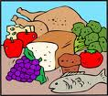
Treatment
Diet change
Lifestyle changes
Surgery
Drugs

Slide 31
Lifestyle changes
Taking rest
No smoking
Doing exercise
Stress reduction

Slide 32
Drugs
5-ASA agents
Glucocorticoids
Antibiotics
Immunosuppressant's
Biological therapy

Slide 33
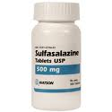
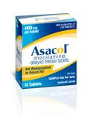
5-ASA Agents
Sulfasalazine (5-aminosalicylic acid and sulfapyridine as carrier substance)
Mesalazine (5-ASA), e.g. Asacol, Pentasa
Balsalazide (prodrug of 5-ASA)
Olsalazine (5-ASA dimer cleaves in colon)

Slide 34
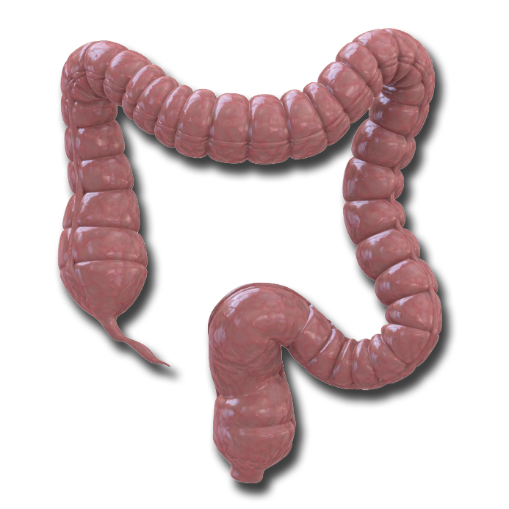
Topical Action of 5-ASA: Extent of Disease Impacts Formulation Choice
Distribution of 5-ASA Preparations
Oral
Varies by agent: may be released in the distal/terminal ileum, or colon¹
Liquid Enemas
May reach the splenic flexure²⁻⁴
Do not frequently concentrate in the rectum³
Suppositories
Reach the upper rectum^{2,5} (15-20 cm beyond the anal verge)
1. Sandborn WJ, et al. Aliment Pharmacol Ther. 2003;17:29-42; 2. Regueiro M, et al. Inflamm Bowel Dis. 2006;12:972–978; 3. Van Bodegraven AA, et al. Aliment Pharmacol Ther. 1996; 10:327-332; 4. Chapman NJ, et al. Mayo Clin Proc. 1992;62:245-248; 5. Williams CN, et al. Dig Dis Sci. 1987;32:71S-75S.
Notes:
34
34
34
34
Topical Action of 5-ASA: Extent of Disease Impacts Formulation Choice
Suppositories
Recommended for use in UP¹ [Regueiro, 2006, p. 973, col 1, para 2, lines 1-2]
Scintographic study shows that suppositories reach the upper rectum (15-20 cm beyond the anal verge).^{1,2} [Regueiro, 2006, p. 973, col 2, para 2, lines 3-4; Williams, 1987, 74S, col 1, para 2, lines 1-3; fig 3]
Liquid enemas
Recommended for use in D-UC.¹ [Regueiro, 2006, p. 974, col 2, para 2, lines 1-2; p. 974, fig 3]
Reach the splenic flexure and into the distal transverse colon.^{1,3,4} [Regueiro, 2006, p. 973, col 2, para 2, lines 4-5; Van, 1996, p. 329, Table 2; p. 330, col 1, para 4; fig 3; Chapman, 1992, p. 247, col 1, para 2-3; p. 248, fig 2]
Do not frequently concentrate in the rectum³ [Van, 1996, p. 329, Table 2]
Oral formulations
Recommended for use in extensive disease⁵ [Kornbluth, 2004, p. 1374, col 1, para 3, lines 1-5]
Delivery site varies by agent and may be released in the distal ileum, terminal ileum, or colon⁶ [Sandborn, 2003, p. 30, Table 1]
References
Regueiro M, Loftus EV, Steinhart H, Cohen RD. Clinical Guidelines for the Medical Management of Left-Sided Ulcerative Colitis and Ulcerative Proctitis: Summary Statement. Inflamm Bowel Dis. 2006;12:972-978.
Williams CN, Haber G, Aquino JA. Double-blind, placebo-controlled evaluation of 5-ASA suppositories in active distal proctitis and measurement of extent of spread using 99mTc-labeled 5-ASA suppositories. Dig Dis Sci. 1987;32: 71S-75S.
van Bodegraven AA, Boer RO, Lourens J, et al. Distribution of mesalazine enemas in active and quiescent ulcerative colitis. Aliment Pharmacol Ther. 1996;10:327-332.
Chapman NJ, Brown ML, Phillips, SF, et al. Distribution of Mesalamine Enemas in Patients with Active Distal Ulcerative Colitis. Mayo Clin Proc. 1992;62:245-248.
Kornbluth A, Sachar DB. Ulcerative colitis practice guidelines in adults (update): American College of Gastroenterology, Practice Parameters Committee. Am J Gastroenterol. 2004;99:1371-1385.
Sandborn WJ, Hanauer SB. Systematic review: the pharmacokinetic profiles of oral mesalazine formulations and mesalazine pro-drugs used in the management of ulcerative colitis. Aliment Pharmacol Ther. 2003;17:29-42.

Slide 35
Antibiotics
No role in active/quienscent UC
Metronidazole is effective in active inflammatory,fistulous & perianal CD.
Ciprofloxacin
Rifaximin

Slide 36
Immunosuppresants
Thiopurines
Azathioprine
6-mercaptopurin
Methotrexate
Cyclosporine

Slide 37
Biological therapy
Infliximab
Anti TNF monoclonal antibody
Infliximab binds to TNF trimers with high affinity, preventing cytokine from binding to its receptors
It also binds to membrane-bound TNF- a and neutralizes its activity & also reduces serum TNF levels.
Use
Fistulizing CD
Severe active CD
Refractory/intolerant of steroids or immunosuppression
Side effects
Infusion reactions, Sepsis, Reactivation of Tb, Increased risk of Tb

Slide 38
Other medications
Anti- diarrheals - Loperamide
Laxatives - senna, bisacodyl
Pain relievers. acetaminophen
Iron supplements
Nutrition

Slide 39
Surgery
Ulcerative colitis
Indications:
Fulminating disease
Chronic disease with anemia, frequent stools, urgency & tenesmus
Steriod dependant disease
Risk of neoplastic change
Extraintestinal manifestations
Severe hemorrhage or stenosis

